Slide 1
Diabetes Readmission prediction
Deepak Mishra

Slide 2
Data Set
encounter_id
patient_nbr
Race
Gender
Age
Weight
admission_type_id
discharge_disposition_id
admission_source_id
time_in_hospital
num_lab_procedures
num_procedures
num_medication
number_outpatient
number_emergency
number_inpatien
diag_1
diag_2
diag_3
number_diagnose
max_glu_serum
Change
diabetesMed
readmitted
encounter_id
patient_nbr
Race
Gender
Age
Weight
admission_type_id
discharge_disposition_id
admission_source_id
time_in_hospital
num_lab_procedures
num_procedures
num_medication
number_outpatient
number_emergency
number_inpatien
diag_1
diag_2
diag_3
number_diagnose
max_glu_serum
Change
diabetesMed
readmitted
100,000 records with data missing for some of the features
Source -- https://archive.ics.uci.edu/ml/datasets/diabetes+130-us+hospitals+for+years+1999-2008

Slide 3
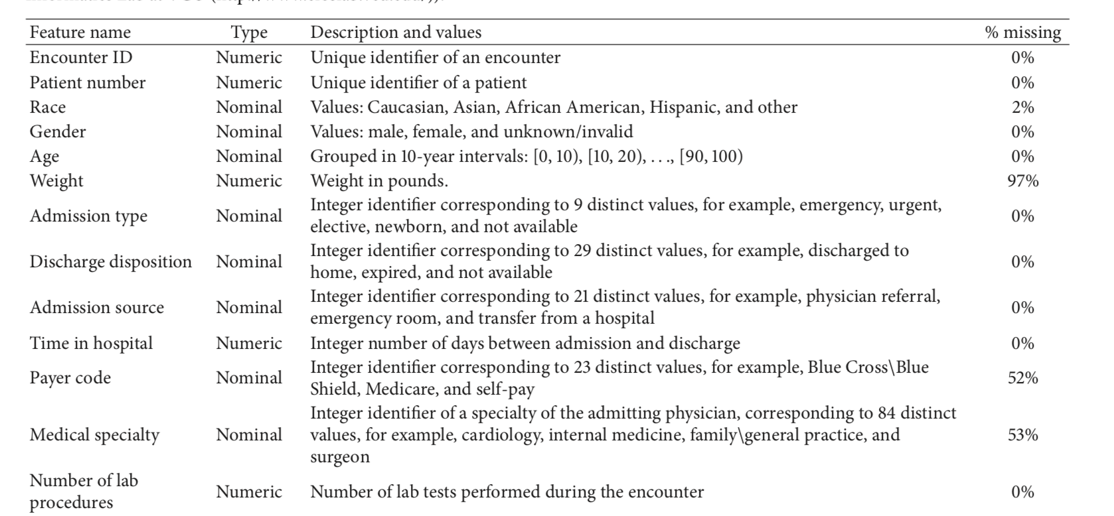
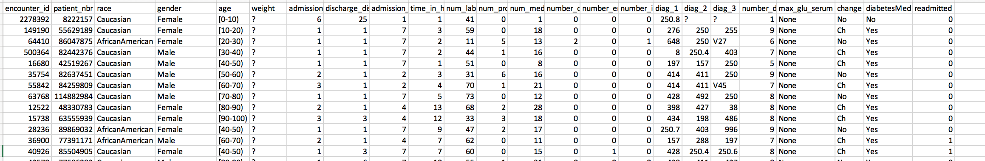

Slide 4
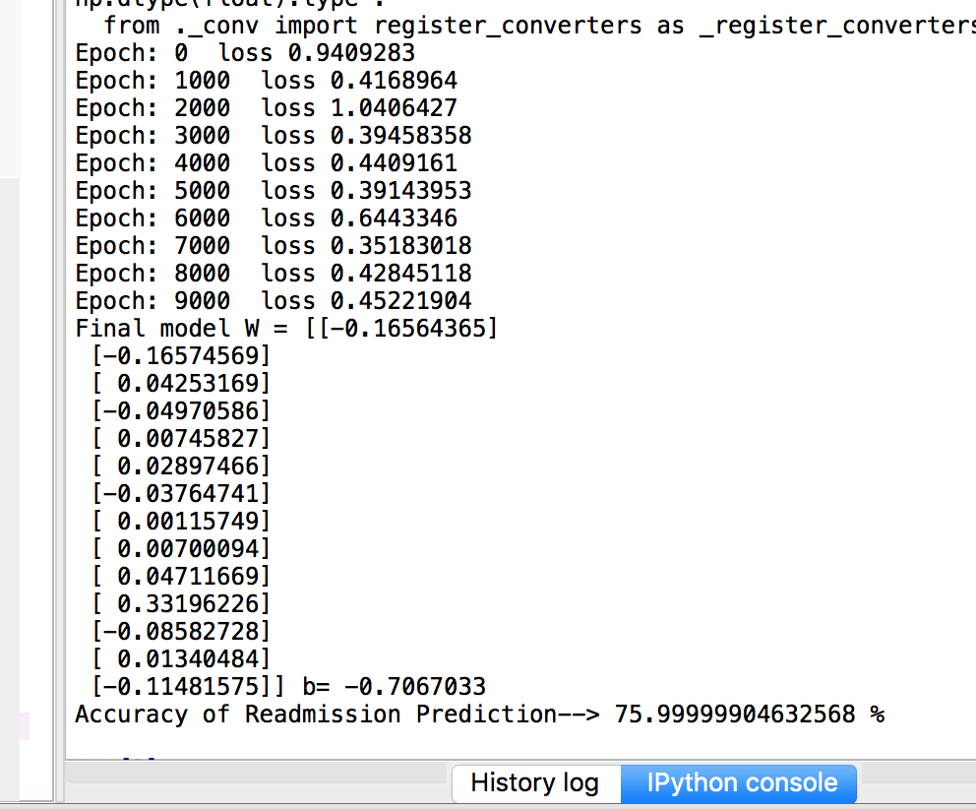
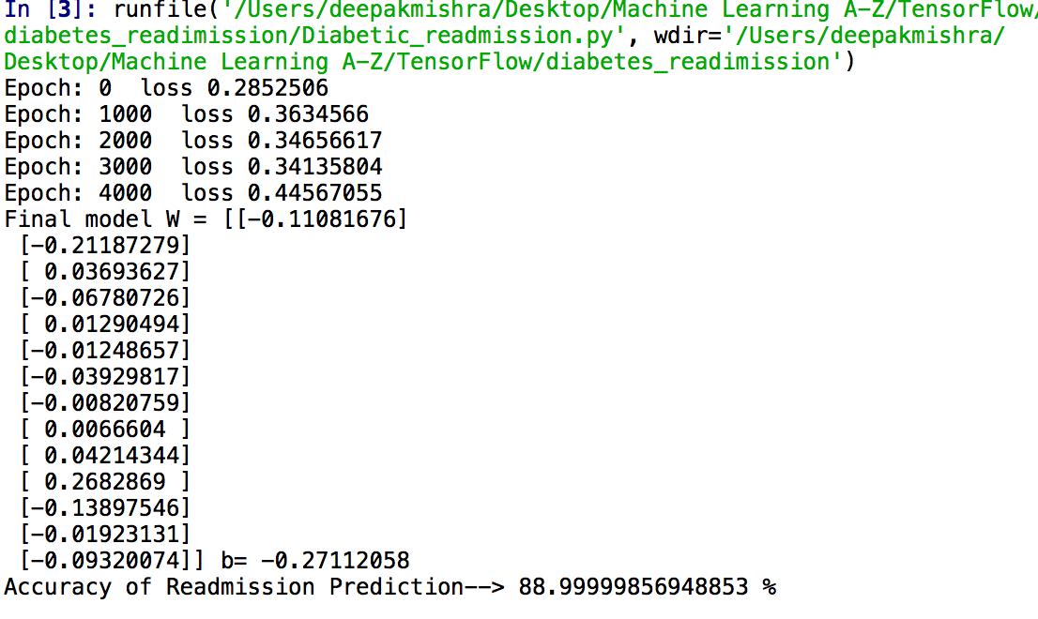
Learning_rate – 0.01 -> 0.005
Iterations - 10,000 ->5,000

Slide 5
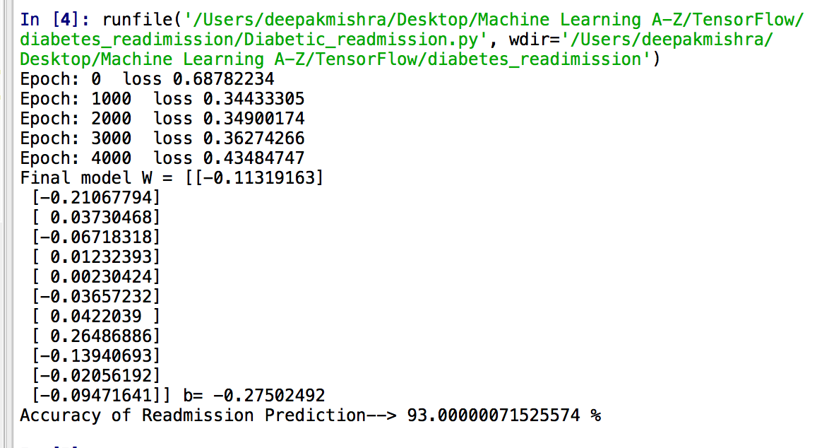
Feature removed
num_medications
number_outpatient

